Slide 1
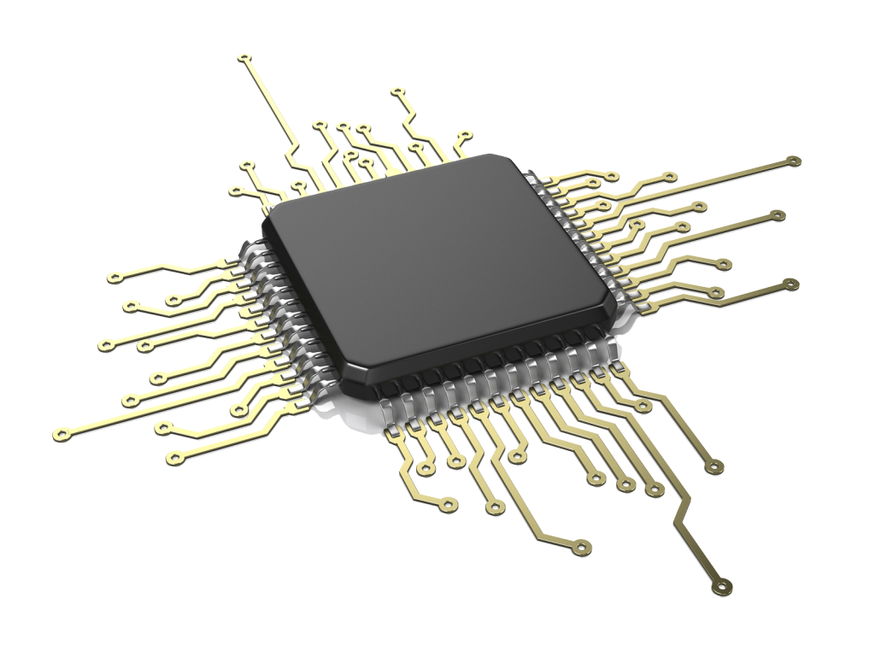
Software Engineering
Embedded Software

Slide 2

Presenting by:
Ankon Karmokar
ID: B190305039
Department of Computer Science & Engineering
Jagannath University

Slide 3
Outline:
Introduction
Definition
Differences
Code
Tools & Technologies
Applications
Benefits
References

Slide 4
Introduction:
Embedded software is software that is not directly visible or invokable by a human user but is part of a system.
For example, the software is embedded in television sets, airplanes, and videogames.
Embedded software is used to control the functions of hardware devices.
Embedded software must be designed to meet real-time performance, energy, and size constraints.

Slide 5
Definition:
Embedded software refers to computer programs or code that are written to control and manage embedded systems.
An embedded system is a specialized computing device designed for a specific task or set of tasks within a larger system.
Embedded software is an integral part of these systems and is designed to meet the specific requirements of the hardware it runs on.

Slide 6
Differences:
Embedded Software | Non-Embedded Software
Runs on embedded systems | Runs on general-purpose computers
Integrated into the hardware | Runs on standalone hardware
Often operates in real-time | May not require real-time operation
Designed for specific tasks | Versatile, handles various tasks
Firmware in appliances, automotive control systems | Operating systems, office software, games

Slide 7
Code (Blink):
int LEDpin = 13;
void setup()
{
pinMode(LEDpin, OUTPUT);
}
void loop()
{
digitalWrite(LEDpin, HIGH);
delay(1000);
digitalWrite(LEDpin, LOW);
delay(1000);
}

Slide 8
Tools & Technologies

Slide 9
Language
C
C++
Implementation Tools and Platforms
WinAVR (Notepad)
Arduino IDE
Proteus 8 Professional
Fritzing

Slide 10
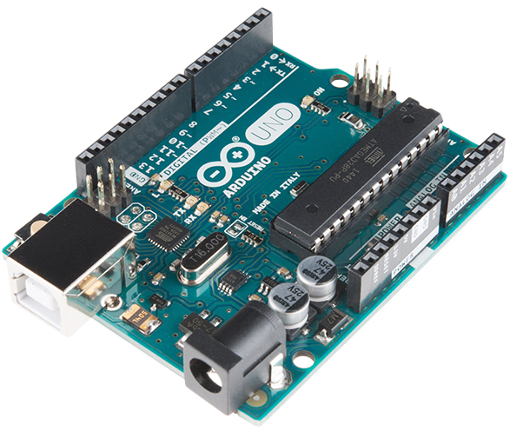
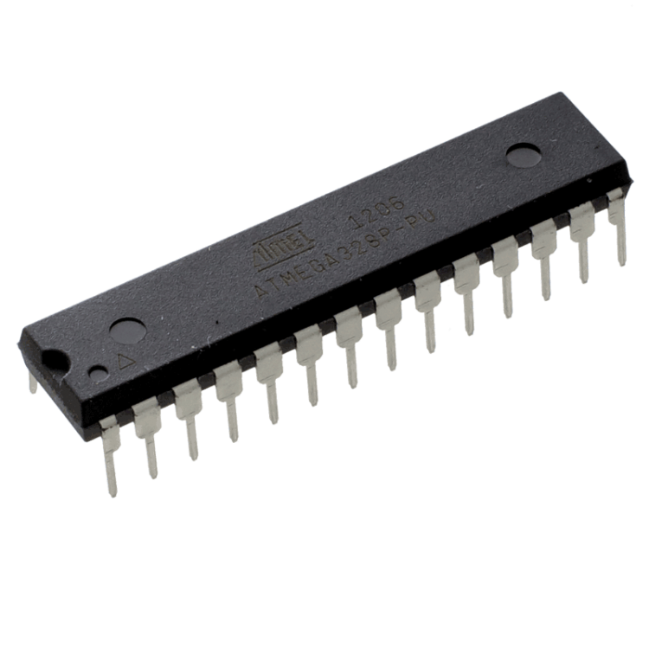
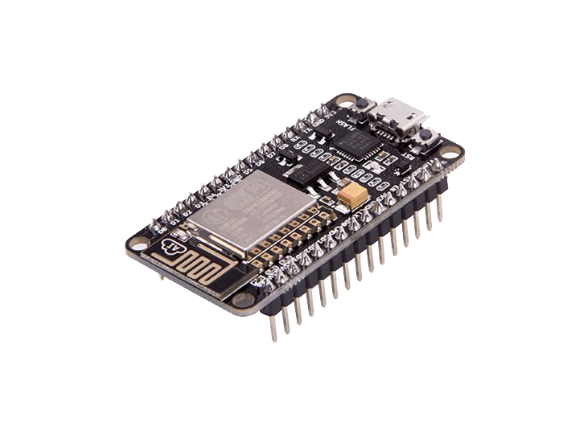
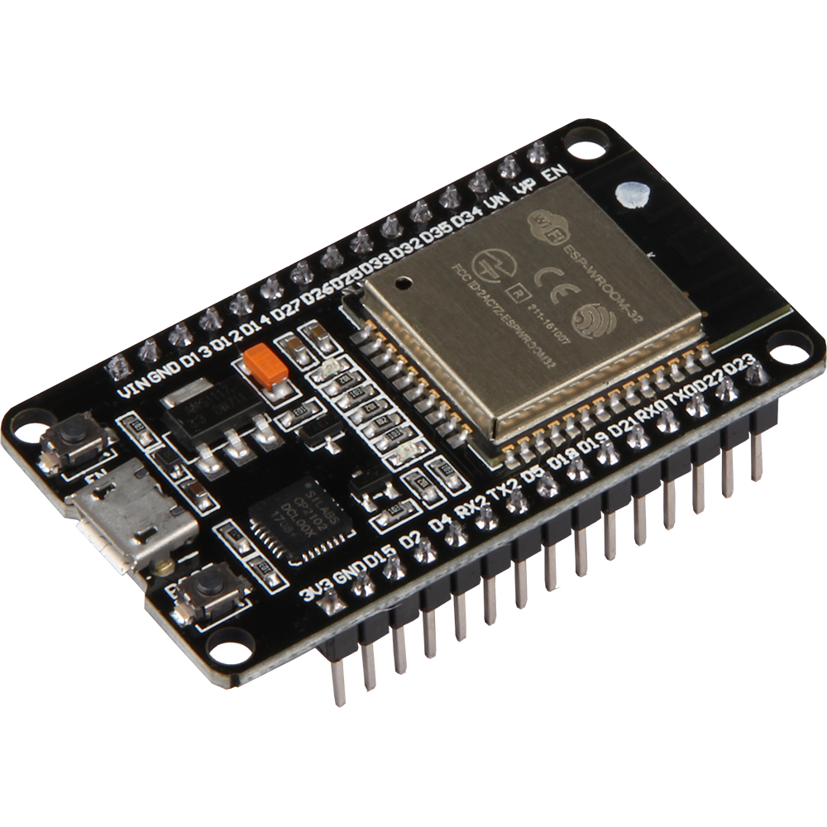
Hardware
Arduino UNO
ATmega 32
ESP32
NodeMCU ESP8266

Slide 11
Emerging Embedded Applications
Intelligent Embedded Systems
Machine Learning for Embedded Applications
Internet-of-Things (IoT)
Smart City
Intelligent Intersection Traffic Signal Control
Robotics and Control Systems
Wireless Sensor Networks
Medical Systems

Slide 12
Benefits of Embedded Software: Embedded software is designed for specific tasks and functions, allowing for optimal performance in a targeted application. Embedded software is designed to respond quickly to input and provide output in real-time, making it suitable for applications like control systems and robotics. Embedded software is often designed to the specific needs of the embedded system, eliminating unnecessary features and reducing development costs. Lastly, Embedded software is tightly integrated with the hardware it runs on, enabling seamless communication and interaction

Slide 13
References:
https://www.ieee-cybermatics.org/2022/icess/
https://chat.openai.com/
https://www.sciencedirect.com/topics/computer-science/embedded-software
https://www.pngwing.com/

Slide 14
Thank You

